Slide 1
The use of deep learning algorithms in geometries
Tutorial
Chrysoula Tzermia and Athanasios G. Malamos,
Dept of Electrical and Computer Engineering, Hellenic Mediterranean University

Slide 2
Τhe artificial intelligence structure
Artificial intelligence (AI) refers to the idea of giving machines or software the ability to make its own decisions based on predefined rules or pattern recognition models
The idea of pattern recognition models leads to machine learning models
NN
Deep learning is a machine learning technique that teaches computers to learn by example.
WEB3D 2022, 2-4 November, Telecom SudParis, Evry, France and Online

Slide 3
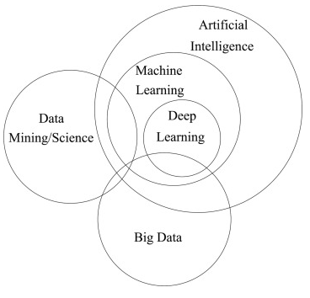
Τhe artificial intelligence structure
Data mining is the process of finding anomalies, patterns and correlations within large data sets to predict outcomes.
Big Data is a collection of data that is huge in volume, yet growing exponentially with time. It is data with so large size and complexity that none of traditional data management tools can store it or process it efficiently. Big data is also data but with huge size.
WEB3D 2022, 2-4 November, Telecom SudParis, Evry, France and Online

Slide 4
Machine Learning
Machine learning is a way that we teach computers to learn things about the world by looking at patterns / examples of things.
data collection
object
Machine learning algorithms build a model based on sample data, known as training data, in order to make predictions or decisions without being explicitly programmed to do so.
test data
training data
correlation
check the correctness of the system
Build the system
identification
WEB3D 2022, 2-4 November, Telecom SudParis, Evry, France and Online

Slide 5
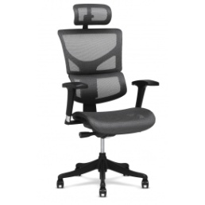
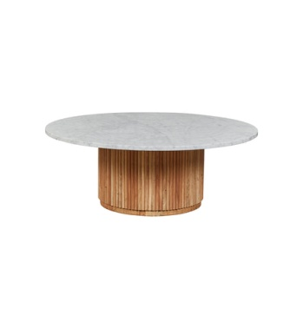
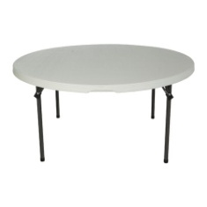
Machine Learning
Chairs
Tables
???
WEB3D 2022, 2-4 November, Telecom SudParis, Evry, France and Online

Slide 6
Neural Networks
WEB3D 2022, 2-4 November, Telecom SudParis, Evry, France and Online

Slide 7
Neural Networks (non-deep structure)
Input Layer
Hidden Layer
Output Layer
Simplest Version
Input Layer
Hidden Layer
Output Layer
More complex version
WEB3D 2022, 2-4 November, Telecom SudParis, Evry, France and Online

Slide 8
Neural Networks (deep structure)
Input Layer
Hidden Layer
Output Layer
Simple Version
Input Layer
Hidden Layer
Output Layer
...
More complex version
WEB3D 2022, 2-4 November, Telecom SudParis, Evry, France and Online

Slide 9
Neurons
A neuron receives
a vector x as input
Input Layer
Hidden Layer
Input Layer
Output Layer
Hidden Layer
Output Layer
The function applies "weights" to the input data
WEB3D 2022, 2-4 November, Telecom SudParis, Evry, France and Online

Slide 10
Neurons, weights and bias
Input Layer
Hidden Layer
Output Layer
x1
w1
Σ
y
If the weight from node 1 to node 2 has greater magnitude, it means that neuron 1 has greater influence over neuron 2.
x2
w2
Input Layer
Hidden Layer
Output Layer
x1
w1
Σ
y
As an input enters the node, it gets multiplied by a weight value and the resulting output is either observed, or passed to the next layer in the neural network.
x2
w2
bias
WEB3D 2022, 2-4 November, Telecom SudParis, Evry, France and Online

Slide 11
Weight VS Bias
Weights
Bias
random values
adjusted toward the desired values and the correct output
represents how far off the predictions are from their intended value
strength of the connection
affects the amount of influence a change in the input will have upon the output
difference between the function's output and its intended output
WEB3D 2022, 2-4 November, Telecom SudParis, Evry, France and Online

Slide 12
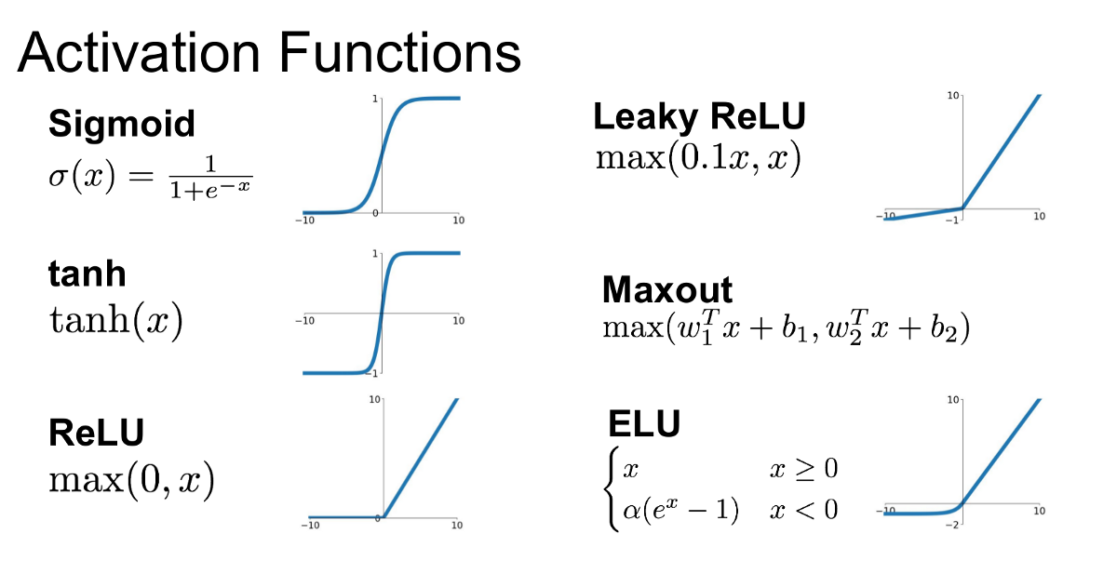
Activation Function
x1
w1
Σ
φ(·)
y
x2
w2
An Activation Function decides whether the neuron's input to the network is important or not in the process of prediction using simpler mathematical operations
bias
WEB3D 2022, 2-4 November, Telecom SudParis, Evry, France and Online

Slide 13
Training (loss function)
}
y = 0 = label for chairs
}
}
M=4 testing samples
ŷ=0
ŷ=1
y = 1 = label for tables
WEB3D 2022, 2-4 November, Telecom SudParis, Evry, France and Online

Slide 14
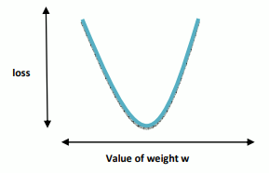
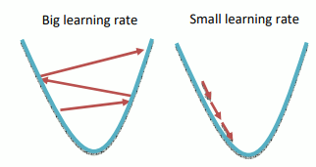
Training (loss function & learning rate)
Thus, the loss function is considering how many bad guesses we had.
Learning rate is a positive number that further determines the frequency we update the weights in the hidden layer of the network.
WEB3D 2022, 2-4 November, Telecom SudParis, Evry, France and Online

Slide 15
Training (epoch & batch size)
Epoch : how many passes the machine learning algorithm has made across the full training dataset
Batches : used to organize data collections (especially when the amount of data is very large).
When the dataset size is d, the number of epochs is e, the number of iterations is i and the batch size is b, the general relationship is
WEB3D 2022, 2-4 November, Telecom SudParis, Evry, France and Online

Slide 16
Supervised Vs Unsupervised learning
Supervised machine learning relies on labelled input and output training data, whereas unsupervised learning processes unlabelled or raw data
Supervised algorithms are trained on labeled datasets an they use this knowledge to try to generalize to neuw examples that it’s never seen before.
Model can measure its accuracy and learn over time
Unsupervised algorithms discover hidden patterns in data without the need of human interaction
Used for three main tasks (clustering , association dimensionality reduction)
They don't make predictions , they only group data together
Learning
Supervised
Unsupervised
WEB3D 2022, 2-4 November, Telecom SudParis, Evry, France and Online

Slide 17
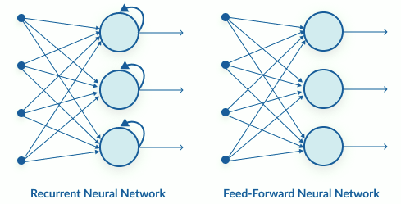
Types of Neural Networks
Artificial Neural Networks (ANN)
Convolution Neural Networks (CNN)
Only the last layer of a CNN is fully connected whereas in ANN, each neuron is connected to every other neurons
Recurrent Neural Networks (RNN)
WEB3D 2022, 2-4 November, Telecom SudParis, Evry, France and Online

Slide 18
Classification VS Segmentation
Classification asks the question: What type of object is this? The goal is to classify the entire point cloud with one label.
Segmentation asks the question: Can you separate this object into distinguished parts?
How to solve them?
What we do have is a metric, which tells us the distance between points. This allows us to group together points that are close to each other in tiny pockets, which are then compressed into a single point. We can repeatedly apply this principle to summarize the geometric information and ultimately label the entire point cloud.
WEB3D 2022, 2-4 November, Telecom SudParis, Evry, France and Online

Slide 19
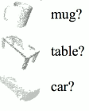
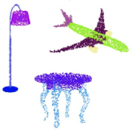
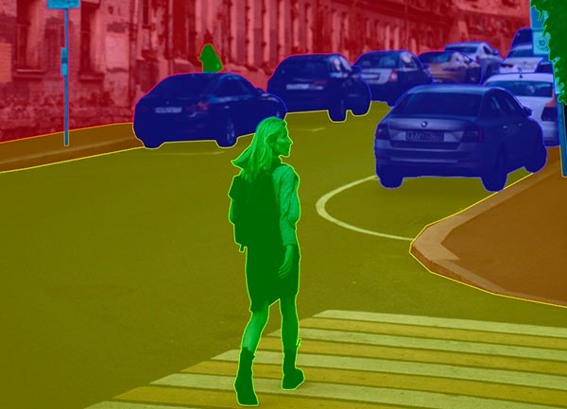
Classification VS Segmentation
Classification
Segmentation
Part
Semantic
}
}
Each object takes one label
Each object takes multiple labels
WEB3D 2022, 2-4 November, Telecom SudParis, Evry, France and Online

Slide 20
Useful algorithms
WEB3D 2022, 2-4 November, Telecom SudParis, Evry, France and Online

Slide 21
Max pooling
The goal is to reduce the dimensionality of an input representation
It aims to reduce overfitting by offering a simplified version of the representation. It also minimizes the computational cost by lowering the number of parameters in the learning process, as well as providing basic translation invariance to the internal representation.
WEB3D 2022, 2-4 November, Telecom SudParis, Evry, France and Online

Slide 22
Normalization
Normalization is the process of transforming data into a scale that is consistent across all dimensions. The most common technique to achieve this is to split the data by the standard deviation of each dimension. It makes sense only if you have reason to suppose that distinct input features have different scales yet are equally important to the learning process.
In general, to get a normalized value between “a” and “b” we use
Normalization gives equal weights / importance to each variable so that no single variable steers model performance in one direction just because they are bigger numbers.
WEB3D 2022, 2-4 November, Telecom SudParis, Evry, France and Online

Slide 23
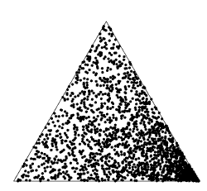
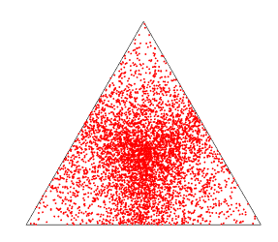
Triangle Point Picking
Given a triangle with one vertex at the origin and the others at positions v1 and v2, one might think that a random point inside the triangle would be given by
where A1 and A2 are uniform variates in the interval [0,1]. However, this samples the triangle nonuniformly, concentrating points in the v1 corner.
Randomly picking each of the trilinear coordinates from a uniform distribution [0,1] also does not produce a uniform point spacing on in the triangle.
WEB3D 2022, 2-4 November, Telecom SudParis, Evry, France and Online

Slide 24
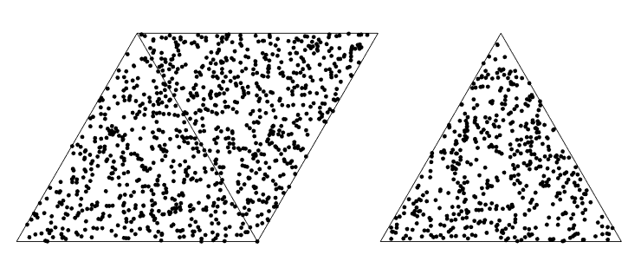
Triangle Point Picking
To pick points uniformly distributed inside the triangle we use the function
WEB3D 2022, 2-4 November, Telecom SudParis, Evry, France and Online

Slide 25
Nearest neighbor
K-nearest neighbor
K=5
WEB3D 2022, 2-4 November, Telecom SudParis, Evry, France and Online

Slide 26
Nearest neighbor
Euclidean distance
One dimension
or
Two dimensions
Higher dimensions
WEB3D 2022, 2-4 November, Telecom SudParis, Evry, France and Online

Slide 27
Manhattan distance
Distance between the projection of the points on the axis
(x1,y1) and (x2,y2) are two points
Manhattan Distance = |x1-x2| + |y1-y2|
Manhattan distance Vs Euclidean distance
B
z
Euclidean distance = z
Manhattan distance = x + y
y
x
A
WEB3D 2022, 2-4 November, Telecom SudParis, Evry, France and Online

Slide 28
Learning in High Dimensions
WEB3D 2022, 2-4 November, Telecom SudParis, Evry, France and Online

Slide 29
Inductive bias or learning bias
The inductive bias (also known as learning bias) of a learning algorithm is the set of assumptions that the learner uses to predict outputs of given inputs that it has not encountered.
In machine learning, the term inductive bias refers to a set of (explicit or implicit) assumptions made by a learning algorithm in order to perform induction, that is, to generalize a finite set of observation (training data) into a general model of the domain.
Generally, every building block and every belief that we make about the data is a form of inductive bias. Inductive biases play an important role in the ability of machine learning models to generalize to the unseen data.
Example:
In the case of rotation symmetry, inductive bias could be phrased as the assumption: “Any information that is not invariant under rotations can and should be ignored”
WEB3D 2022, 2-4 November, Telecom SudParis, Evry, France and Online

Slide 30
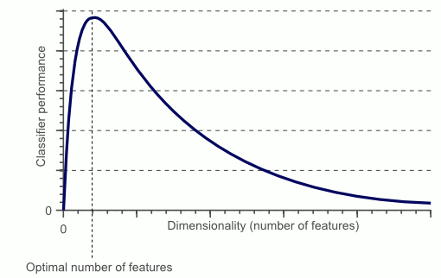
Classifier Performance and Dimensionality
The sample density decreases exponentially with the increase of the dimensionality
When we keep adding features without increasing the number of training samples as well, the dimensionality of the feature space grows and becomes sparser and sparser.
Solution
Dimensionality reduction: transformation of data from a high-dimensional space into a low-dimensional space so that the low-dimensional representation retains some meaningful properties of the original data
WEB3D 2022, 2-4 November, Telecom SudParis, Evry, France and Online

Slide 31
Euclidean data Vs Non-Euclidean data
Euclidean geometry seeks to understand the geometry of flat, two-dimensional spaces.
Non-Euclidean geometry studies curved, rather than flat, surfaces.
Non-Euclidean data: refers to a set of data points which do not fit into 2-dimensional space (for example: manifolds or spherical graphs where you have more than two positional coordinate axes and subsequently you need more than two coordinate values to specify the position of each data point
Euclidean data: data which is sensibly modelled as being plotted in n-dimensional linear space, for example image files where the x and y coordinates refer to the location of each pixel
WEB3D 2022, 2-4 November, Telecom SudParis, Evry, France and Online

Slide 32
Geometric Deep Learning
Models
WEB3D 2022, 2-4 November, Telecom SudParis, Evry, France and Online

Slide 33
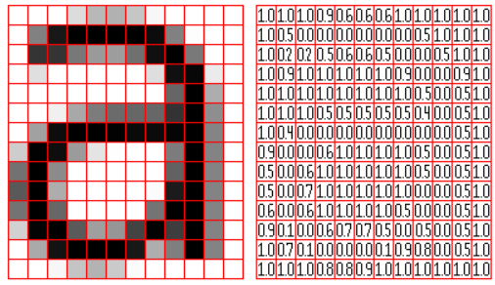
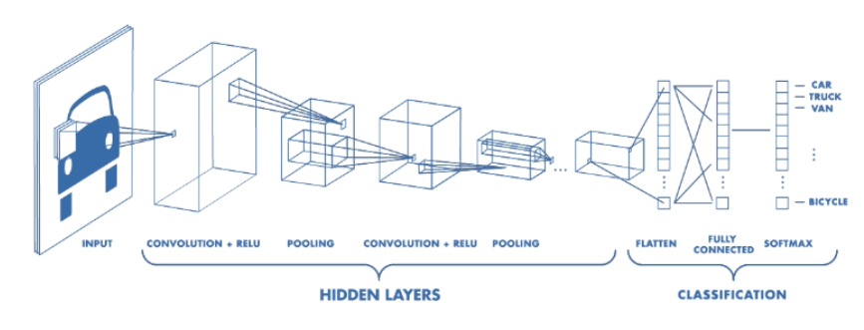
CNN
A Convolutional Neural Network, also known as CNN or ConvNet, is a class of neural networks that specializes in processing data that has a grid-like topology, such as an image.
A CNN typically has three layers: a convolutional layer, a pooling layer, and a fully connected layer.
WEB3D 2022, 2-4 November, Telecom SudParis, Evry, France and Online

Slide 34
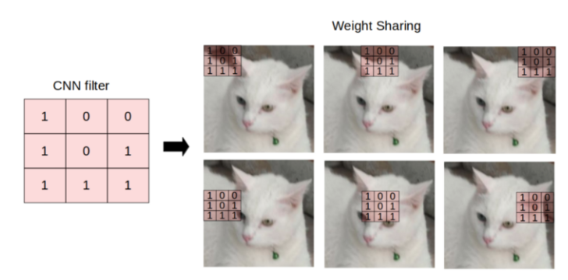
CNN
It refers to multiplying the input neurons with a set of weights that are commonly known as filters or kernels. The filters act as a sliding window across the whole image and enable CNNs to learn features from neighboring cells.
WEB3D 2022, 2-4 November, Telecom SudParis, Evry, France and Online

Slide 35
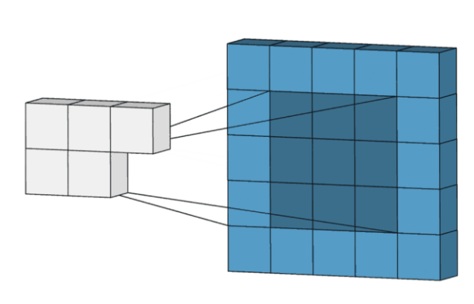
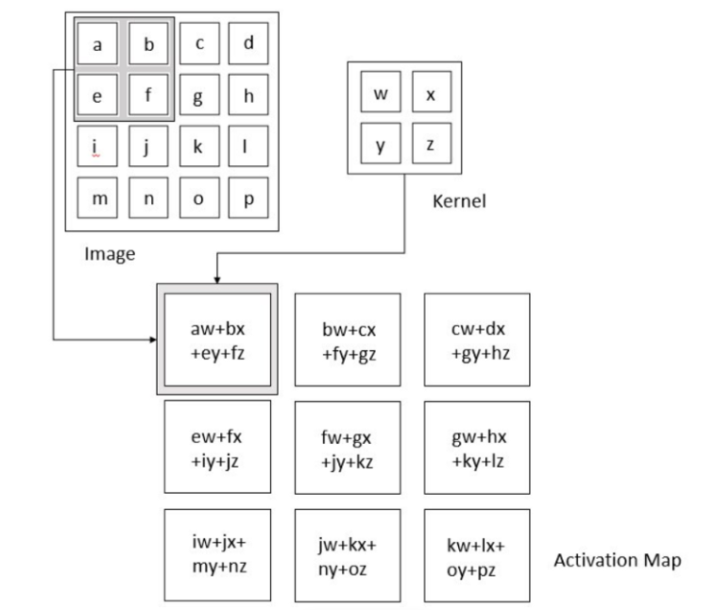
CNN
Convolution Layer
It carries the main portion of the network’s computational load.
This layer performs a dot product between two matrices, where one matrix is the set of learnable parameters otherwise known as a kernel, and the other matrix is the restricted portion of the receptive field.This produces a two-dimensional representation of the image known as an activation map that gives the response of the kernel at each spatial position of the image.
WEB3D 2022, 2-4 November, Telecom SudParis, Evry, France and Online

Slide 36
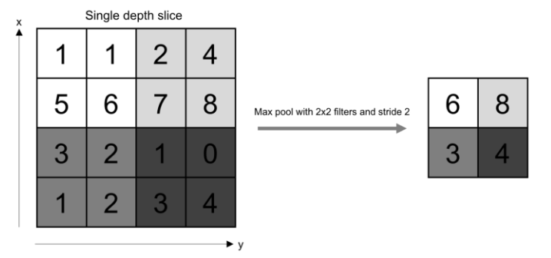
CNN
Pooling Layer
The pooling layer replaces the output of the network at certain locations by deriving a summary statistic of the nearby outputs. This helps in reducing the spatial size of the representation, which decreases the required amount of computation and weights. The pooling operation is processed on every slice of the representation individually
WEB3D 2022, 2-4 November, Telecom SudParis, Evry, France and Online

Slide 37
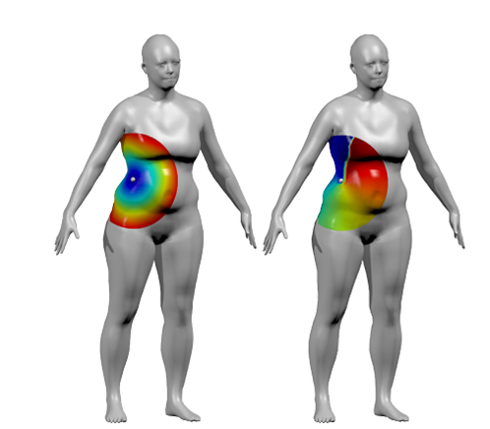
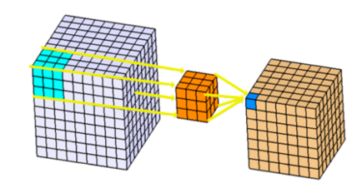
CNN
The CNN can now be run on the 3D object itself rather than a 2D image of the object.
Analogously to 2D CNNs, the kernel would pass through every “pixel” represented as a node in a point-cloud (basically a graph that wraps around the 3D object)
3D Convolution Layer
3D convolutions applies a 3 dimensional filter to the dataset and the filter moves 3-direction (x, y, z) to calculate the low level feature representations. Their output shape is a 3 dimensional volume space such as cube or cuboid.
WEB3D 2022, 2-4 November, Telecom SudParis, Evry, France and Online

Slide 38
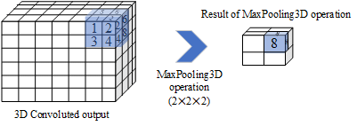
CNN
3D Pooling Layer
The dimensions that the layer pools over depends on the layer input:
For 3-D image input (data with five dimensions corresponding to pixels in three spatial dimensions, the channels, and the observations), the layer pools over the spatial dimensions.
For 3-D image sequence input (data with six dimensions corresponding to the pixels in three spatial dimensions, the channels, the observations, and the time steps), the layer pools over the spatial dimensions.
For 2-D image sequence input (data with five dimensions corresponding to the pixels in two spatial dimensions, the channels, the observations, and the time steps), the layer pools over the spatial and time dimensions.
A 3-D max pooling layer performs downsampling by dividing three-dimensional input into cuboidal pooling regions, then computing the maximum of each region.
WEB3D 2022, 2-4 November, Telecom SudParis, Evry, France and Online

Slide 39
Graph Neural Networks
A Graph neural network (GNN) is a class of artificial neural networks for processing data that can be represented as graphs
GCN models learns the features by inspecting neighboring nodes.
The major difference between CNNs and GNNs is that CNNs are specially built to operate on regular (Euclidean) structured data, while GNNs are the generalized version of CNNs where the numbers of nodes connections vary and the nodes are unordered (irregular on non-Euclidean structured data).
WEB3D 2022, 2-4 November, Telecom SudParis, Evry, France and Online

Slide 40
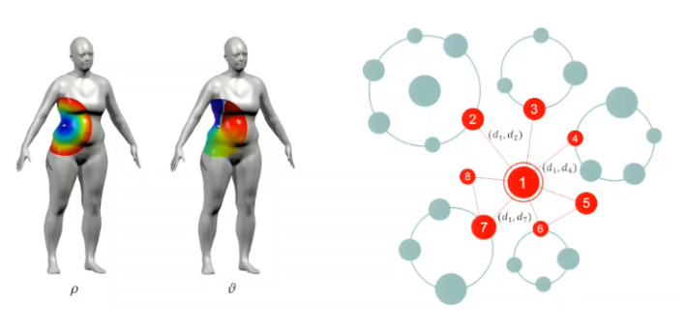
Graph Neural Networks
Considers distance and angle from a point on 3D images or the degree of neighboring nodes on graphs. The position and values of kernels on the neighborhood structure are not fixed, but rather learned from the training process.
WEB3D 2022, 2-4 November, Telecom SudParis, Evry, France and Online

Slide 41
Recurrent Neural Networks
Recurrent neural network (RNN): class of artificial neural networks where connections between nodes can create a cycle, allowing output from some nodes to affect subsequent input to the same nodes. Commonly used in speech recognition and natural language processing. (works sequentially)
Output
Output
Hidden State
Hidden
Hidden
Hidden state is a representation of the previous inputs
Input
Input
feed-forward
RNN
WEB3D 2022, 2-4 November, Telecom SudParis, Evry, France and Online

Slide 42
Recurrent Neural Networks
example:
What
time
is
it
?
encode & output production
In a hidden state from the previous step
In a hidden state from the previous step
In a hidden state from the previous step
In a hidden state from the previous step
RNN has info about the word “What”
RNN has info about the words “What” and “time”
RNN has info about the words “What”,“time” and “is”
RNN has info about the words “What”, “time”, “is” and “it”
RNN has info about the words “What”, “time”, “is”, “it” and “?”
WEB3D 2022, 2-4 November, Telecom SudParis, Evry, France and Online

Slide 43
PointNet & MeshNet
WEB3D 2022, 2-4 November, Telecom SudParis, Evry, France and Online

Slide 44
PointNet
Classifying Point Clouds
WEB3D 2022, 2-4 November, Telecom SudParis, Evry, France and Online

Slide 45
PointNet Architecture (1/4)
WEB3D 2022, 2-4 November, Telecom SudParis, Evry, France and Online

Slide 46
PointNet, global feature vector
PointNet employs maximum pooling. The output of max pooling compresses the n points in the input point cloud to a subset of points, similar to how the max operator compresses numerous real-valued inputs to a single value. The critical point set is made up of points that contribute to and define the global feature vector, and it encodes the input with a sparse collection of key points.
The network learns to summarize an input point cloud using a sparse collection of important points, which closely matches to the skeleton of objects according to visualization
WEB3D 2022, 2-4 November, Telecom SudParis, Evry, France and Online

Slide 47
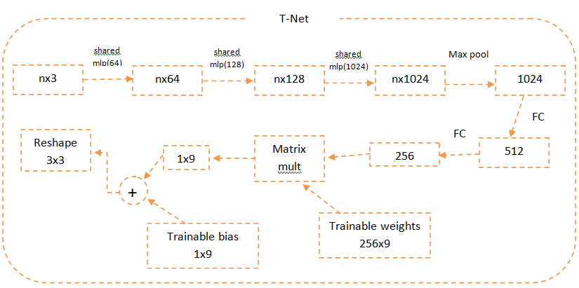
PointNet Architecture (2/4)
A mini-network (T-net) predicts an affine transformation matrix, which we then apply directly to the coordinates of input points. MLPs (or fully connected layers) are used to translate the input points to a higher-dimensional space independently and identically: max pooling is employed to encode a global feature vector, which is subsequently reduced to R256 with FC layers. The final FC layer's input-dependent features are then merged with globally trainable weights and biases to produce a 3-by-3 transformation matrix.
WEB3D 2022, 2-4 November, Telecom SudParis, Evry, France and Online

Slide 48
Transformation matrix
The feature transformation matrix is constrained to be close to an orthogonal matrix:
where A is the feature alignment matrix predicted by a mini-network. As a result, an orthogonal transformation is preferred since it does not lose information in the input
WEB3D 2022, 2-4 November, Telecom SudParis, Evry, France and Online

Slide 49
PointNet Architecture (3/4)
WEB3D 2022, 2-4 November, Telecom SudParis, Evry, France and Online

Slide 50
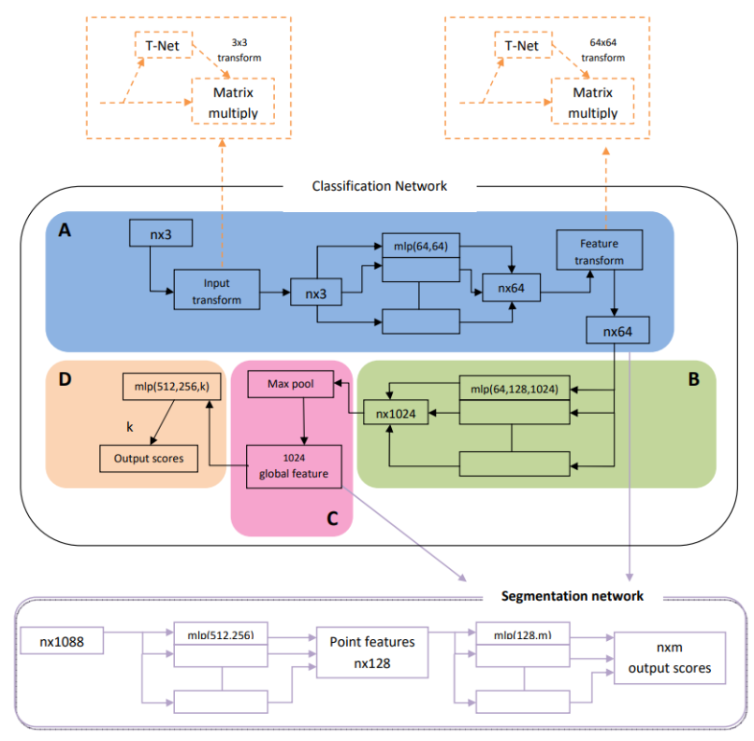
PointNet Architecture (4/4)
WEB3D 2022, 2-4 November, Telecom SudParis, Evry, France and Online

Slide 51
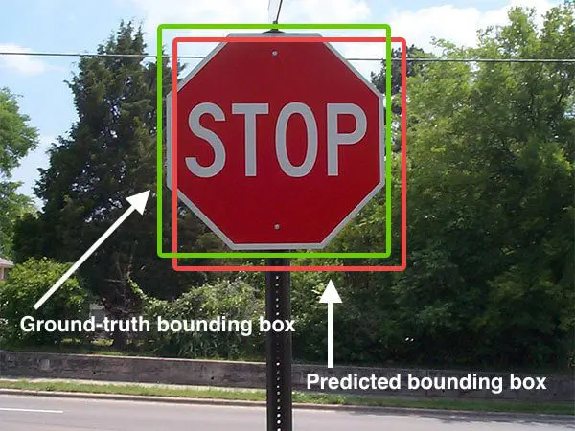
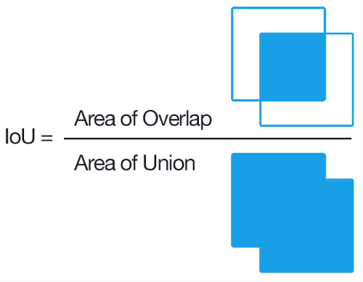
PointNet Segmentation
T-Net
output
Local point features
}
skip links: skips some of the layers in the neural network and feeds the output of one layer as the input to the next layers
output
concatenated for each point
max pooling
global feature
Part segmentation
3D Object Part Segmentation
Baseline 3D CNN Segmentation Network
one-hot vector (1 × N matrix) indicating the class of the input and concatenate it with the max pooling layer’s output
convert it to the volumetric representation as a occupancy grid with resolution 32 × 32 × 32
increase neurons in some layers
five 3D convolution operations each with 32 output channels and stride of 1 are sequentially applied to extract features
add skip links to collect local point features in different layers
a sequence of 3D convolutional layers with kernel size 1 × 1 × 1 is appended to the computed feature map to predict segmentation label for each voxel.
concatenate the skip links to form point feature input to the segmentation network
WEB3D 2022, 2-4 November, Telecom SudParis, Evry, France and Online

Slide 52
MeshNet
Classifying Meshes
WEB3D 2022, 2-4 November, Telecom SudParis, Evry, France and Online

Slide 53
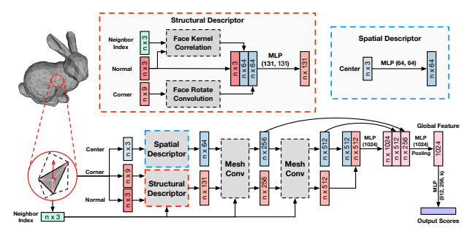
MeshNet Architecture
WEB3D 2022, 2-4 November, Telecom SudParis, Evry, France and Online

Slide 54
MeshNet
MeshNet: learns on mesh data directly for 3D shape representation.
Key ideas :
Regard face as the only unit and define a connection between two faces if they share a common edge. There are several advantages of this simplification. First is that one triangular face can connect with no more than three faces, which makes the connection relationship regular and easy to use. They solve the disorder problem with per-face processes and a symmetry function
Split feature of face. We only need to know “where you are” for a point, while we also want to know “what you look like” for a face.
Split the feature of faces into spatial feature and structural feature = helps us to capture features more explicitly.
Face Information:
Center: center point coordinate
Corner: vectors from the center point to three vertices
Normal: the unit normal vector
mesh data to list of faces
initial values of a face
Neighbor Information:
Neighbor Index: indexes of the connected faces (filled with the index of itself if the face connects with less than three faces)
WEB3D 2022, 2-4 November, Telecom SudParis, Evry, France and Online

Slide 55
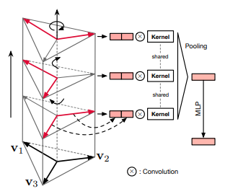
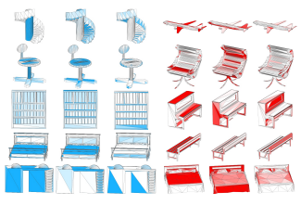
MeshNet Architecture
center value
input
Spatial descriptor
output
initial spatial feature
Structural descriptor
face kernel correlation
face rotate convolution
input
output
aiming to capture the “outer” structure of faces and explore the environments where faces locate
calculate the kernel correlation between each face and kernel, and more similar pairs will get higher values.
corner value
features with the length of K2
face rotate convolution
face kernel correlation
WEB3D 2022, 2-4 November, Telecom SudParis, Evry, France and Online

Slide 56
MeshNet Architecture
designed to expand the receptive field of faces, which denotes the number of faces perceived by each face, by aggregating information of neighboring faces. In this process, features related to spatial positions should not be included directly
Mesh Convolution
combination of spatial and structural feature
concatenate two features
MLP
global feature
aggregation of structural feature
output
feature of a face with features of its connected faces.
input
methods
Average pooling: calculates the average value of features in each channel
structural feature and neighbor index
Max pooling: calculates the max value of features in each channel
Concatenation: concatenates the feature of face with feature of each neighbor respectively, passes these pairs through a shared MLP and applies a max pooling to the results.
WEB3D 2022, 2-4 November, Telecom SudParis, Evry, France and Online

Slide 57
Useful tools
WEB3D 2022, 2-4 November, Telecom SudParis, Evry, France and Online

Slide 58
Tensorflow
TensorFlow is a Python library for fast numerical computing created and released by Google. It is a foundation library that can be used to create Deep Learning models directly or by using wrapper libraries that simplify the process built on top of TensorFlow.
For Web
For Mobile & Edge
For Production
Use off-the-shelf JavaScript models or convert Python TensorFlow models to run in the browser or under Node.js.
TensorFlow Lite is a mobile library for deploying models on mobile, microcontrollers and other edge devices.
TFX to create and manage a production pipeline
A TFX pipeline is a sequence of components that implement an ML pipeline which is specifically designed for scalable, high-performance machine learning tasks. Components are built using TFX libraries which can also be used individually.
Retrain pre-existing ML models using your own data.
Convert a TensorFlow model into a compressed flat buffer with the TensorFlow Lite Converter.
Build and train models directly in JavaScript using flexible and intuitive APIs.
Take the compressed .tflite file and load it into a mobile or embedded device.
Quantize by converting 32-bit floats to more efficient 8-bit integers or run on GPU.
WEB3D 2022, 2-4 November, Telecom SudParis, Evry, France and Online

Slide 59
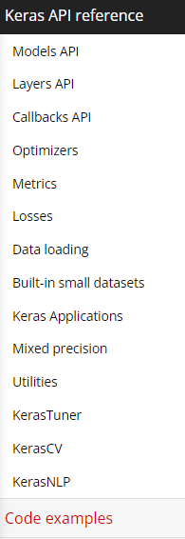
Keras
Keras is the most used deep learning framework .
Built on top of TensorFlow 2, Keras is an industry-strength framework that can scale to large clusters of GPUs or an entire TPU pod.
You can export Keras models to JavaScript to run directly in the browser, to TF Lite to run on iOS, Android, and embedded devices. It's also easy to serve Keras models as via a web API.
keras web page
WEB3D 2022, 2-4 November, Telecom SudParis, Evry, France and Online

Slide 60
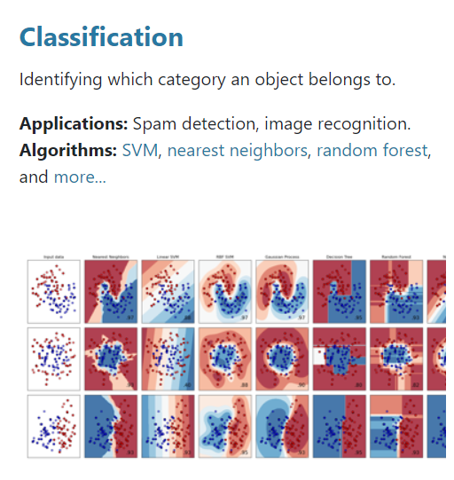
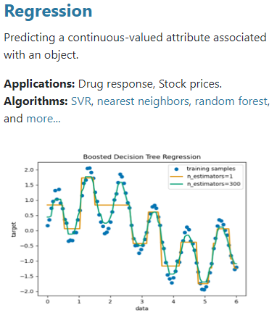
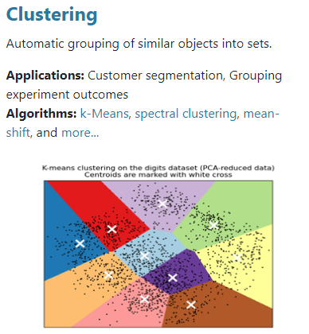
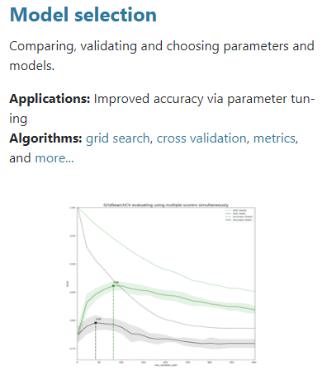
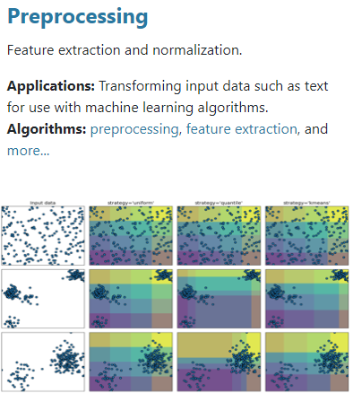
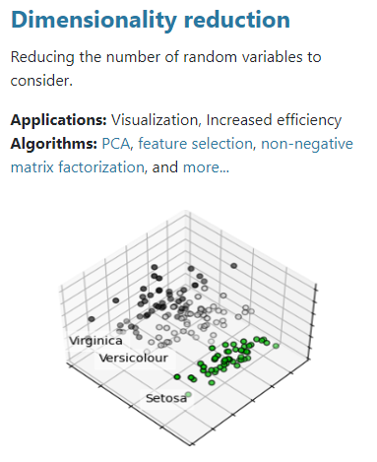
Scikit-learn
Simple and efficient tools for predictive data analysis
Accessible to everybody, and reusable in various contexts
Built on NumPy, SciPy, and matplotlib
Open source, commercially usable - BSD license
WEB3D 2022, 2-4 November, Telecom SudParis, Evry, France and Online

Slide 61
Our experiments
Live Predictions
WEB3D 2022, 2-4 November, Telecom SudParis, Evry, France and Online

Slide 62
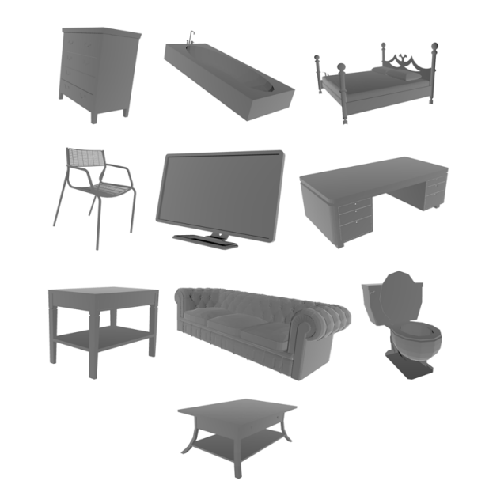
Dataset
https://modelnet.cs.princeton.edu/
ModelNet40 contains CAD models from the 40 categories used to train the deep network in our 3D deep learning project
WEB3D 2022, 2-4 November, Telecom SudParis, Evry, France and Online

Slide 63
Libraries
WEB3D 2022, 2-4 November, Telecom SudParis, Evry, France and Online

Slide 64
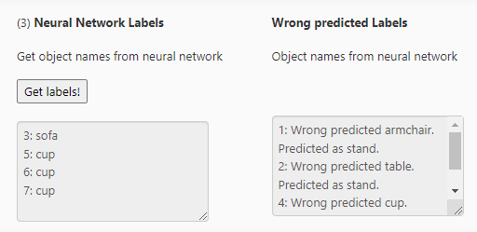
from Python to web
python
js file
WEB3D 2022, 2-4 November, Telecom SudParis, Evry, France and Online

Slide 65
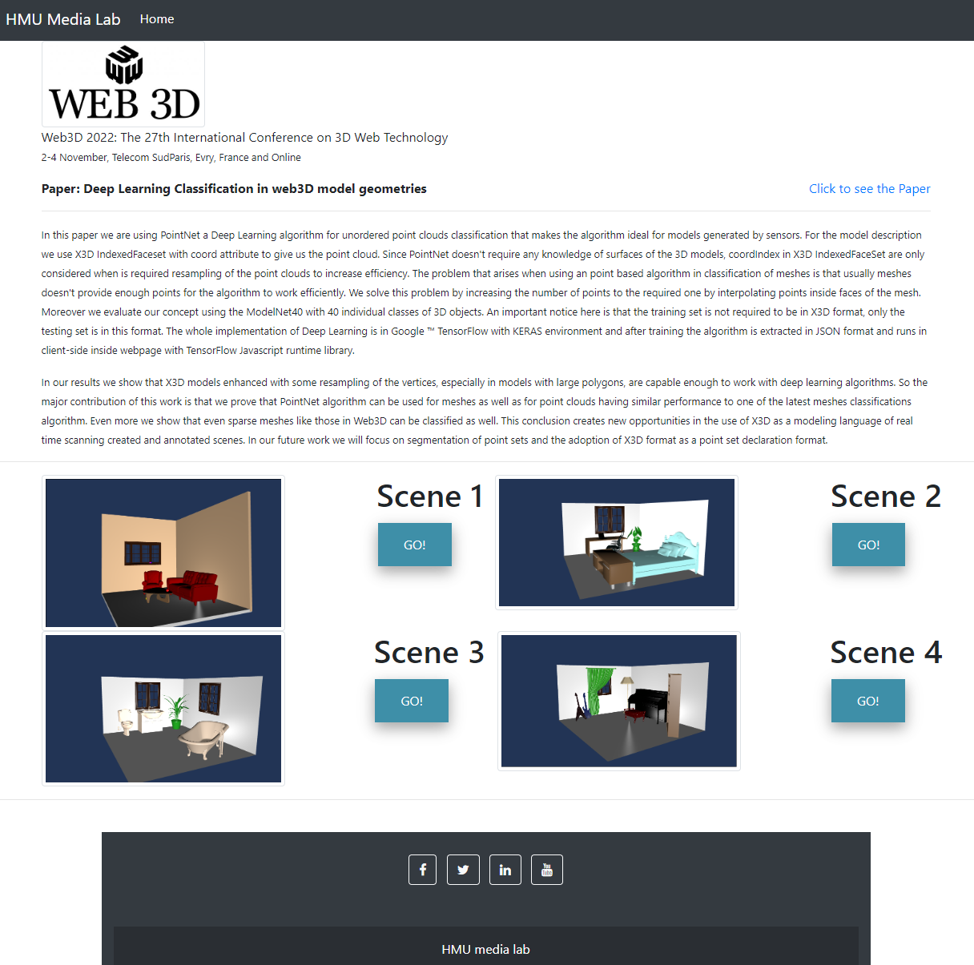
Our Demo webpage https://medialab.hmu.gr/minipages/3DRtree/LowPolyRoom/
Seminar information
Paper information
3D scenes for live prediction
Runs Better with Mozilla Firefox
WEB3D 2022, 2-4 November, Telecom SudParis, Evry, France and Online

Slide 66
Our Demo webpage https://medialab.hmu.gr/minipages/3DRtree/LowPolyRoom/
General information about the scene
3D scene
Bounding box & Network’s prediction
WEB3D 2022, 2-4 November, Telecom SudParis, Evry, France and Online

Slide 67
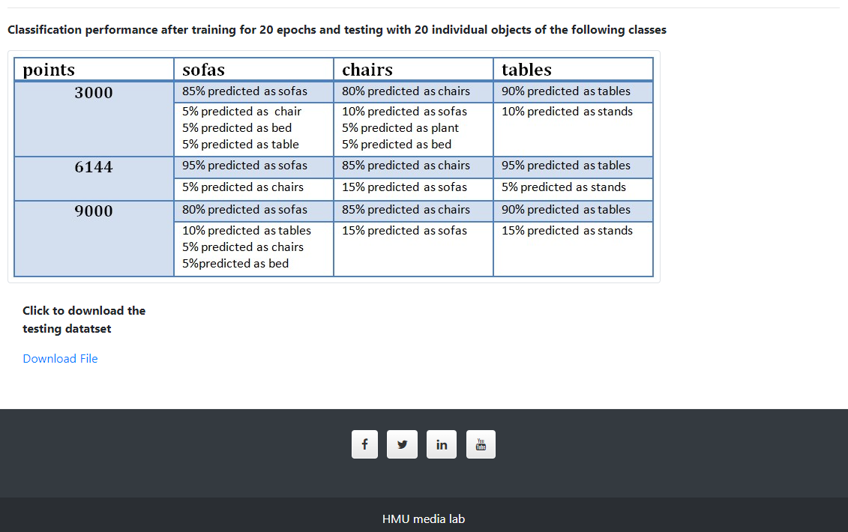
Our Demo webpage https://medialab.hmu.gr/minipages/3DRtree/LowPolyRoom/
WEB3D 2022, 2-4 November, Telecom SudParis, Evry, France and Online

Slide 68
Our Demo webpage https://medialab.hmu.gr/minipages/3DRtree/LowPolyRoom/

Slide 69
Thank you!
WEB3D 2022, 2-4 November, Telecom SudParis, Evry, France and Online

